Slide 1

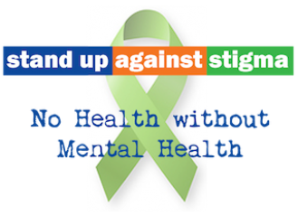

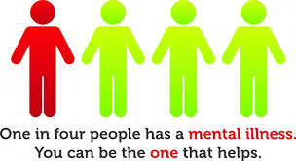
Help. Hope. Recovery.
Mental Illness 101
Homeless Connections
November 18th, 2014
Notes:
What is driving the changes within NFV: best practice in the field of MH Peer education & support, evidence-based curriculums and data driven program options, innovative and creative collaborations, quality assurance processes, all grounded by SAMHSA’s MH recovery model. This morning, we want to share with you how this solid foundation is what underlies the NAMI affiliate that is serving our community today.

Slide 2
Learning Objectives
Role of NAMI in Fox Valley
Definition of Mental Health vs Mental Illness
Impact of Mental Illness
Myth Busters & Mental Illness Conditions
Barriers of Treatment
Recovery & NAMI Outreach

Slide 3


MISSION:
NAMI Fox Valley works to empower and support everyone touched by mental illness. We strive to eliminate stigma and nurture recovery through education, support, advocacy and outreach.
VISION:
We envision a community, free of stigma, that supports and promotes mental health and recovery.

Slide 4
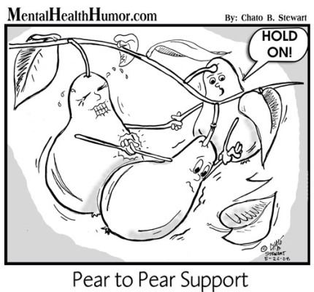
The Gifts of Peer Support
“Been There, Done That”
Insight
Compassion
Hope
Trust
Whole- Health
Self Direction
Notes:
The perspective and unique abilities of peer support providers strengthen the integrated care team in many ways. There are six key gifts peer providers bring to the integrated care team:
The Gift of Insight. Internalized shame shatters a person’s sense of self-worth. For many, the impact on their daily lives and interactions can be harder to overcome than the symptoms of their illness. Peer providers have insight on how internalized shame results from discrimination, social exclusion, poverty, homelessness, and hopelessness.
The Gift of “Been There, Done That.” Peer providers eliminate the “you do not know what it’s like” excuse. Peer providers can make others living with mental illnesses or addictions feel comfort in the fact that they are not alone; they have a person on their side that has been through similar experiences and has gotten through them.
The Gift of Compassion. Because of their lived experience, peer support providers understand and are inherently grateful for the very services they are now providing to others. This gratitude often manifests itself in deep compassion for their peers.
The Gift of Hope. Working with someone who has moved from hopelessness to hope is extremely empowering. People can often see themselves in the peer providers, which gives them hope over their whole health.
The Gift of Trust. Peer providers are in a unique position to develop a relationship of trust. Peers are often more willing to share their real issues, concerns, hopes, and dreams with a peer provider rather than non-peer, clinical staff.
The Gift of Whole- Health Self-Management. Peer providers have developed the gift of self-managing their lives holistically, including both mind and body. This experience with self-managing their whole health is one of the most powerful gifts peer providers can give. They have learned to recognize triggers and early warning signs, counteract the negative impact of stress, and create plans for taking care of themselves.

Slide 5

Mental Health Problems vs. Mental Illness What’s the difference?
Clear trigger (often situational)
Coping skills relieve symptoms
Defined period of time
Notes:
Signs and symptoms of insufficient intensity or duration to meet the criteria for any mental disorder.
Mental health problems may warrant active efforts in health promotion, prevention, and treatment.
Clear trigger – situational (break up, death, loss, injury, conflict, trauma, financial trouble, job stress, life changes – wedding, birth, move, hormonal changes, illness
Coping skills relieve / Mental health promotion – talking to healthcare provider, asking close allies to watch for intensity/duration, seek support, adequate rest, diet, exercise
Defined period of time – symptoms most every day for 2 week period / grief 2 months

Slide 6

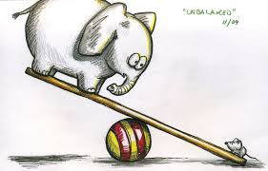
“A state of being in which the demands, responsibilities, and requirements of daily life are PERCEIVED to outweigh the resources with which to manage them.”
Demands
Resources
Mental health problems may inhibit the ability
to maintain balance by eating away at resources
Notes:
Clear trigger – situational (break up, death, loss, injury, conflict, trauma, financial trouble, job stress, life changes – wedding, birth, move, hormonal changes, illness

Slide 7
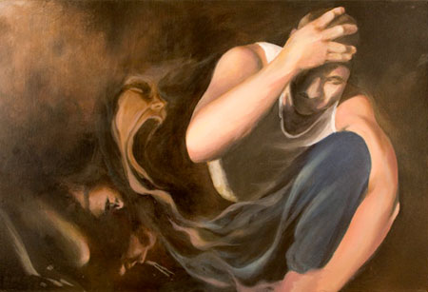
Defining Mental Illness
Mental illnesses are medical conditions that disrupt a person’s thinking, feeling, mood, behavior and ability to relate to others, and causes the person distress and difficulty in daily functioning.
(The Science of Mental Illness. National Institutes of Health; National Institute of Mental Health)
Notes:
Mental illnesses are medical conditions that disrupt a person’s thinking, feeling, mood, ability to relate to others, and daily functioning.
They are medical conditions that often result in a diminished capacity for coping with the ordinary demands of life.
Painting by New York artist Amber Christian Osterhout. She was inspired by her brother, who has schizophrenia, to create an art exhibit titled Gaining Insight with the intention of educating others about the reality of mental illness.

Slide 8
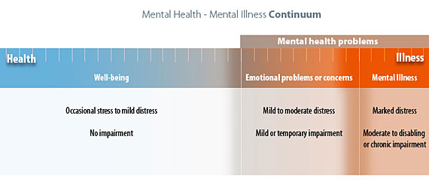
Mental Health – Mental Illness Continuum
Notes:
Well-being: At the “healthy” end of the continuum are individuals experiencing well-being, a state of good mental and emotional health. These individuals may experience stress and discomfort resulting from occasional problems of everyday life, but they experience no impairments to daily functioning.
Emotional problems or concerns: For individuals experiencing “emotional problems”, discomfort has risen to the level of distress accompanied by the beginning of impairments in functioning (e.g. insomnia, lack of concentration or loss of appetite). As the level of distress increases, individuals may seek professional counseling; those positioned at the right hand margin might be given diagnoses such as “situational” depression or “general anxiety”, indicating disorders with mild or temporary impairment.
Mental Illness: “Emotional problems” are raised to the level of “illness” by increase in distress and level of impairment. Located at the right end of the continuum, “mental illness” is characterized by alterations in thinking, mood, or behavior. Mental illnesses include relatively common disorders such as depression and anxiety as well as major disorders such as schizophrenia. Individuals with these disorders typically experience chronic or long-term impairments that range from moderate to disabling in nature.

Slide 9
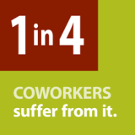
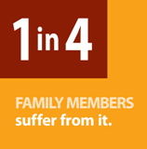
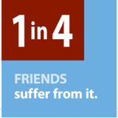
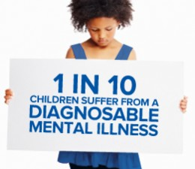
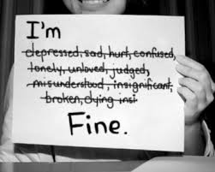
How common is mental illness?
1 in 4 adults – approximately
65 million Americans
1 IN 5
Notes:
How common is mental illness?
Mental illnesses are common
One in four adults—approximately 65 million Americans—experience a mental health disorder in a given year.
One in seventeen lives with a serious mental illness, and one in ten children have a serious mental or emotional disorder.

Slide 10
What causes mental illness?
Social/ Environmental
Negative life experiences (trauma, stress and loss)
Adverse childhood experiences
Biological
Genetics
Environmental exposures before birth (viruses, toxins, alcohol, drugs)
Chemical
Biochemical changes
Hormonal imbalances
Neurotransmitters

Slide 11

The Impact of Mental Illness
All together, America’s cumulative mental health
issues are costing the U.S. economy about
a half-trillion dollars.
(That’s more than the government spent on
all of Medicare during the last fiscal year)
Notes:
In the United States, the annual economic, indirect cost of mental illness is estimated to be $300 billion.
Most of that amount - approximately $63 billion - reflects the loss of productivity as a result of illness, absenteeism & presenteeism
Mental health disorders are the third most costly medical condition (in payments made).
Heart disease is first; trauma related disorders/injuries second; and cancer is fourth.
Depression is the leading cause of disability for Americans ages 15 to 44.

Slide 12
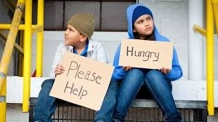
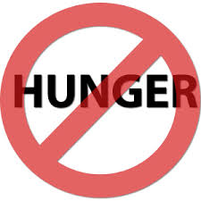
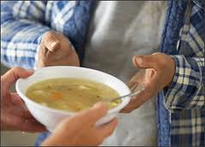

Mental Illness creates a barrier to meeting the basic human needs of food, shelter and meaningful engagement
Notes:
Children living in poverty are more likely to be exposed to and experience traumatic events that have long lasting effects on development and mental and physical health.
41% of families in which there is parental mental illness are living in poverty. (nmha data)
Less than a quarter of those parents have had steady employment in the last month. (nmha data)
A recent study has found that 28 percent of homeless people with previous psychiatric hospitalizations obtained some food from garbage cans and 8 percent used garbage cans as a primary food source.
When someone is struggling with the symptoms of their mental illness, just like struggling with any other physical illness, it impacts their ability to function in daily life, including employment.
Additionally, many people in poverty are uninsured or underinsured with the dilemma of choosing to pay for mental health treatment and medications, OR food and housing.
People experiencing hunger or facing debts are more likely to suffer from mental disorders.

Slide 13
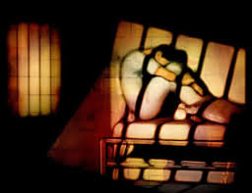

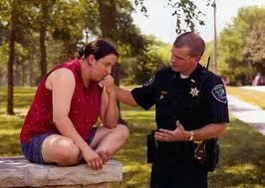


Our Country’s Largest Mental Health Facility:
Notes:
The criminalization of the mentally ill:
America has lost 90% of its psychiatric hospital beds since 1960, a shrinkage that has corresponded with the growth of the prison population.
Instead of hospitalizing people with mental illness, many are jailed or imprisoned.
24% percent of state prisoners and 65% percent of local jail prisoners have a recent history of a mental health disorder.
70% of youth in juvenile justice systems have at least one mental disorder with at least 20% experiencing significant functional impairment from a serious mental illness.
By some estimates, 16% of inmates are suffering symptoms of severe mental illness.
Imprisoning people acting on symptoms of mental illness isn't good for the people, law enforcement, jails and prisons or anyone else.
The sane alternative: court-ordered outpatient treatment.
Results in lower arrest and incarceration rates — and costs far less than jails, hospitals and emergency rooms.
Outagamie County Mental Health Court

Slide 14

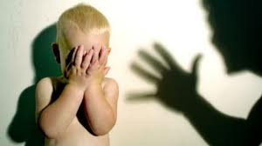
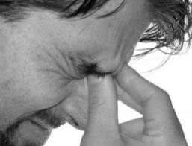
People with mental illness are FAR more likely to be victims than perpetrators
More than 50% report being a victim of a crime in the past year.
3x more likely to be assaulted or mugged
5x more likely to experience assault
(women are 10x more likely)
Studies have found that reports to police
were often dismissed or not believed.
Notes:
The Impact of Trauma & Victimization
According to the National Center for Post Traumatic Stress Disorder, about 60 percent of men and 50 percent of women will experience a traumatic event in their lifetime and the numbers are even higher for members of the armed forces. People with mental illness are far more likely to be victims than perpetrators of violent crime and are especially vulnerable to being victimized. This frequently involves acts such as theft of clothing or money, but also includes assault, rape or being killed. People with severe mental illnesses are 3 times more likely to be attacked, raped or mugged than the general population. More than half of people with mental illness have experienced a crime in the last year. People with severe mental illness are five times more likely to experience assault (women are 10 times more likely). Studies have also found victims with mental illness saying that their reports to the police were often dismissed or disbelieved.

Slide 15
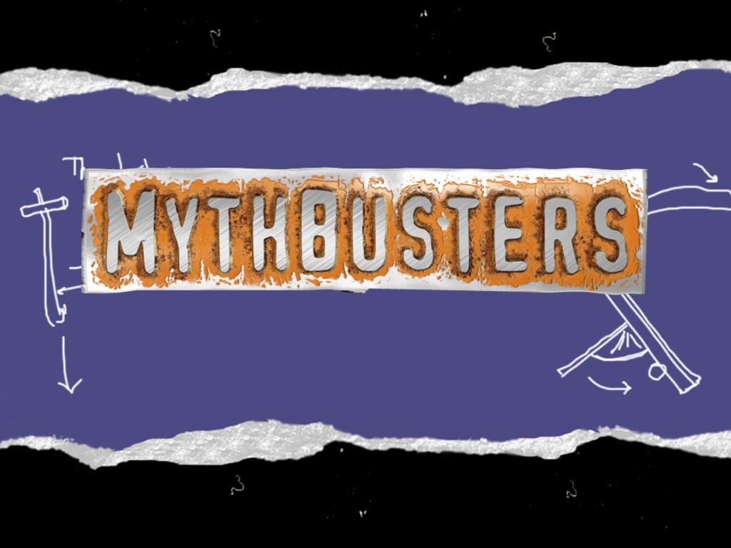
MYTH: Depressed people are just lazy or weak. They need to pull themselves together and stop feeling sorry for themselves.
Notes:
Myth: Depressed people are just lazy or weak. They need to pull themselves together and stop feeling sorry for themselves.
Fact: When people are clinically depressed, they can’t “snap out of” it anymore than they can “snap out of” an ulcer or diabetes. Although we don’t know the exact cause of clinical depression, we do know it is a medical illness with biological components. We also know that genetics and certain brain chemicals play a part. In short, we know enough to treat it effectively.

Slide 16
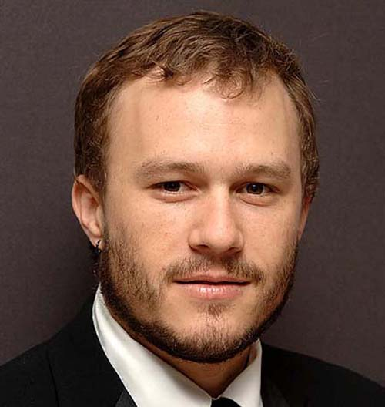


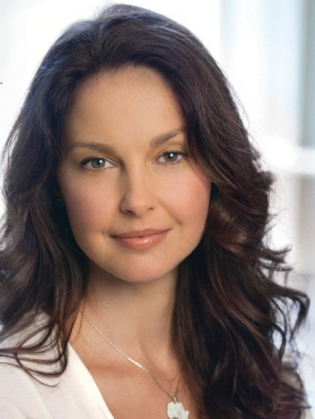
Depression: Feelings of depression are normal reactions to loss, life's struggles, or an injured self-esteem; however, when feelings of intense sadness last for many weeks and impact ability to function, it is something more than sadness. It may very well be clinical depression -- a treatable medical condition.
Actor
Heath
Ledger
(1979-2008)
President Abraham
Lincoln
Singer
Bruce
Springsteen
Actress
Ashley
Judd
Notes:
Major depressive disorder is a serious medical illness affecting 15 million American adults or approximately 5-8 percent of the adult population in a given year.
Unlike normal emotional experiences of sadness, loss or passing mood states, major depression is persistent
Major depression can significantly interfere with an individual’s thoughts, behavior, mood, activity and physical health.
Among all medical illnesses, major depression is the leading cause of disability in the United States and many other developed countries.
Symptoms can include:
Sadness
Loss of interest or pleasure in activities you used to enjoy
Change in weight
Difficulty sleeping or oversleeping
Energy loss
Feelings of worthlessness
Thoughts of death or suicide

Slide 17
MYTH: Mania is “FUN!”
Notes:
Myth: People with mental illnesses are violent and unpredictable.
Fact: Actually, the vast majority of people with mental health conditions are no more violent than anyone else. People with mental illnesses are much more likely to be the victims of crime. You probably know someone with a mental illness and don't even realize it.

Slide 18
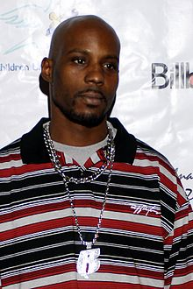

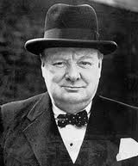

Bipolar Disorder Medical illness which causes shifts in mood, energy and ability to function.
British PM
Winston
Churchill
Actress
Catherine
Zeta-Jones
Rapper
DMX
Newscaster
Jane
Pauley
Notes:
Bipolar Disorder, also known as manic-depressive illness, is a serious medical illness that causes shifts in a person's mood, energy, and ability to function.
It is different from the normal ups and downs that everyone goes through.
The symptoms of bipolar disorder are severe.
They may go from overly energetic, "high" and/or irritable, to sad and hopeless, and then back again.
They often have normal moods in between. The up feeling is called mania. The down feeling is depression. Hence, the name “manic depression,” as it used to be known.
Bipolar disorder can run in families.

Slide 19
MYTH: Some people are just worry warts
or neurotic, and there is nothing that
can really make any difference.
Notes:
Myth: People with mental illnesses are violent and unpredictable.
Fact: Actually, the vast majority of people with mental health conditions are no more violent than anyone else. People with mental illnesses are much more likely to be the victims of crime. You probably know someone with a mental illness and don't even realize it.

Slide 20




Anxiety Disorders Anxiety disorders have different symptoms, but all the symptoms cluster around excessive, irrational fear and dread.
Pitcher
Zach
Greinke
Actor
Johnny
Depp
Singer
Adele
TV Personality
Howie Mandel
Notes:
More than 40 million are affected by these debilitating illnesses each year.
Affect 20% of the population at any given time
May co-occur with other disorders
Symptoms:
- Frightened, distressed or uneasy
- Panic Attacks: physical symptoms like shortness of breath, chest pressure,
heart palpitations, sweating
- Expresses fears – objects, activities, places, feelings, etc.
- Avoidance of activities, people, places
Generalized anxiety disorder - Chronic, exaggerated worry about everyday routine life events and activities, lasting at least six months; almost always anticipating the worst even though there is little reason to expect it. Accompanied by physical symptoms, such as fatigue, trembling, muscle tension, headache, or nausea.
Post-Traumatic Stress Disorder- Persistent symptoms that occur after experiencing a traumatic event such as war, rape, child abuse, natural disasters, or being taken hostage. Nightmares, flashbacks, numbing of emotions, depression, and feeling angry, irritable, distracted and being easily startled are common.
Phobias - People who suffer from phobias experience extreme fear or dread from a particular object or situation.
Panic disorder - Panic disorders involve sudden, intense feelings of terror for no apparent reason and symptoms similar to a heart attack.
OCD - People with obsessive-compulsive disorder try to cope with anxiety by repeating words or phrases or engaging in repetitive, ritualistic behavior such as constant hand washing.

Slide 21
Anxiety Disorders Separation Anxiety Disorder Specific Phobia Panic Disorder Agoraphobia Generalized Anxiety Disorder Other Specified Anxiety Disorder Unspecified Anxiety Disorder | Obsessive-Compulsive and Related Disorders Hoarding Disorder Trichotillomania (Hair-Pulling Disorder) Excoriation (Skin-Picking) Disorder Substance/Medication-Induced Obsessive-Compulsive and Related Disorder Obsessive-Compulsive and Related Disorder Due to Another Medical Condition | Trauma- and Stressor-Related Disorders Reactive Attachment Disorder Dis-inhibited Social Engagement Disorder Posttraumatic Stress Disorder Acute Stress Disorder Adjustment Disorders

Slide 22
MYTH: People can be convinced their irrational fears/thoughts are just silly.
Notes:
Myth: People with mental illnesses are violent and unpredictable.
Fact: Actually, the vast majority of people with mental health conditions are no more violent than anyone else. People with mental illnesses are much more likely to be the victims of crime. You probably know someone with a mental illness and don't even realize it.

Slide 23
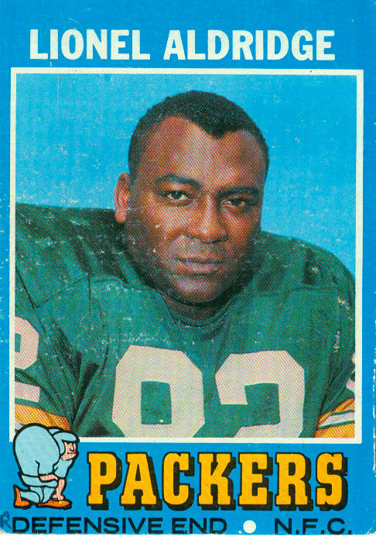


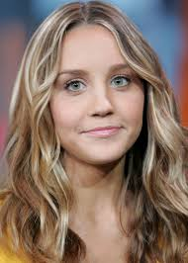
Thought Disorders Schizophrenia & Schizoaffective Disorder interfere with a person’s ability to think clearly, know what is reality and what is not and manage activities of daily living.
Green Bay
Packer
Lionel
Aldridge
Nobel prize winner,
John Nash,
Subject of the movie
“A Beautiful Mind.”
Beach Boys
Singer
Brian
Wilson
Actress
Amanda
Bynes
Notes:
Thought disorders involve distorted awareness and thinking.
The most common symptoms of psychotic disorders are hallucinations -- the experience of images or sounds that are not real, such as hearing voices,
And delusions, which are false beliefs that the ill person accepts as true, despite evidence to the contrary.
Schizophrenia is a chronic, severe, and disabling brain disorder that affects about 1.1 percent of the adult U.S. population in given year.
People with schizophrenia sometimes hear voices others don’t hear, believe that others are broadcasting their thoughts to the world, or become convinced that others are plotting to harm them.
These experiences can make them fearful and withdrawn and cause difficulties when they try to have relationships with others.
Other symptoms:
Disorganized speech: Includes changing the subject, pauses, incomplete thoughts, etc. Often referred to as “word salad.”
Grossly disorganized or catatonic behavior: poor personal hygiene, wearing layers of clothing in summer or insufficient clothing in winter, etc.
Negative symptoms: flat affect or appearing to not have any emotional response or expressing strained response
Schizoaffective Disorder
Symptoms of both schizophrenia and a mood disorder.
Symptoms can include:
Delusions
Hallucinations
Other symptoms that are characteristic of schizophrenia (i.e. paranoia, anxiety)
Significant disturbances in their mood (e.g., affective symptoms).

Slide 24
MYTH: Personality disorders are just an excuse to “be a jerk.”
Notes:
Myth: People with mental illnesses are violent and unpredictable.
Fact: Actually, the vast majority of people with mental health conditions are no more violent than anyone else. People with mental illnesses are much more likely to be the victims of crime. You probably know someone with a mental illness and don't even realize it.

Slide 25

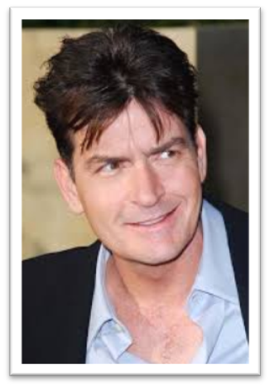

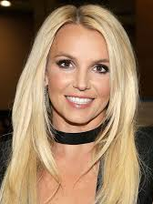
Personality Disorders Personality disorders create rigid and unhealthy patterns of thinking, functioning and behaving which impacts perceptions of relationships and situations.
Singer
Britney
Spears
NFL Star
Brandon
Marshall
Actor
Charlie
Sheen
Actress
Angelina
Jolie
Notes:
Most of us have an understanding of “personality.” We even categorize “personality types.” We know which personalities are compatible with our own.
We have a sense of what a disordered personality is – people who are abrasive, irritable, needy, overly emotional, fearful or eccentric are easily identified.
Personality Disorders are described as an enduring pattern of experience and behavior that deviates from an individual’s culture.
The pattern includes ways of interpreting self, other people or events, extreme range of intensity and appropriateness of emotional response, ability to establish and maintain healthy relationships and impulse control
Personality disorders include paranoid, histrionic, antisocial, borderline, narcissistic, avoidant and dependent.
Multiple personality disorder is now called dissociative identity disorder. People with this disorder develop alters, usually as a coping mechanism for severe trauma.

Slide 26
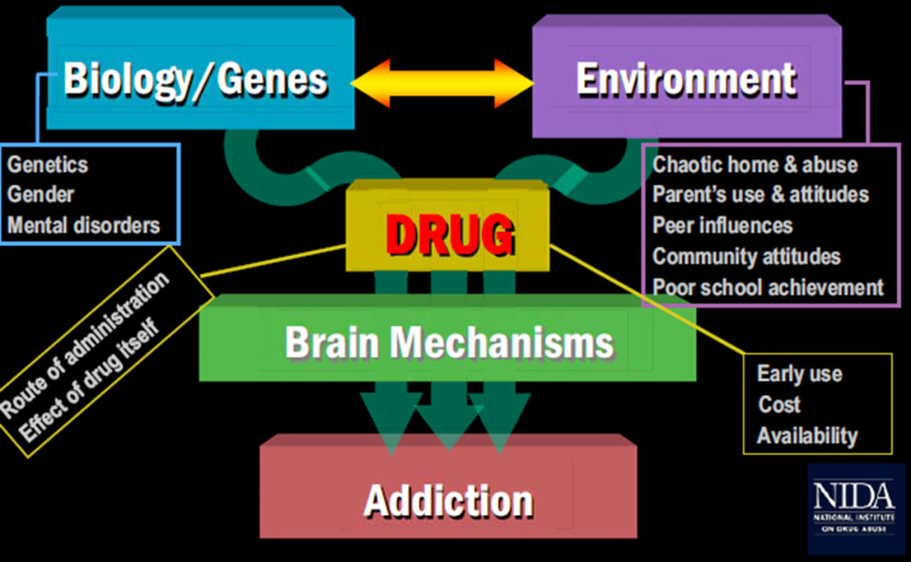
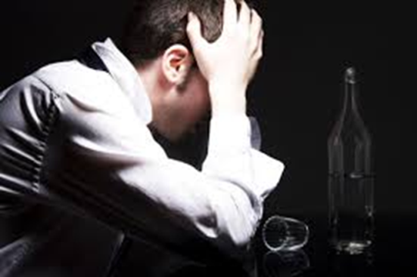
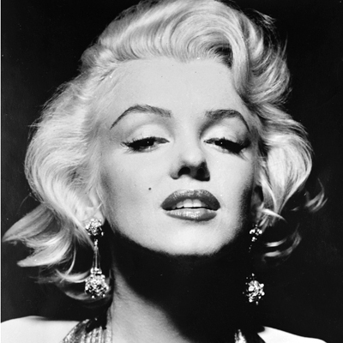
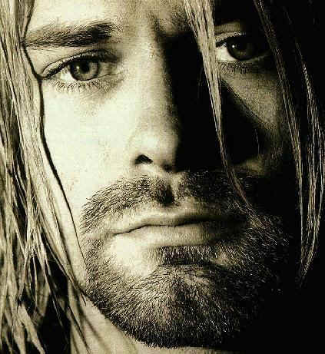


Dual Diagnosis: Mental Illness & Substance Use Disorder
Singer
Kurt
Cobain
(1967-1994)
Singer
Amy Winehouse
(1983-2011)
Icon Marilyn
Monroe
(1926-1962)
Actor
Corey Monteith
(1982-2013)
Notes:
Dual diagnosis is a term used to describe people with mental illness who have coexisting problems with drugs and/or alcohol.
The relationship between the two is complex, and the treatment of people with co-occurring substance abuse (or substance dependence) and mental illness is more complicated than the treatment of either condition alone.
This is unfortunately a common situation—many people with mental illness have ongoing substance abuse problems, and many people who abuse drugs and alcohol also experience mental illness.
What is the relationship between substance use and mental illness?
Drugs and alcohol can be a form of self-medication.
Drugs and alcohol can worsen underlying mental illnesses.
Drugs and alcohol can cause a person without mental illness to experience the onset of symptoms for the first time
According to the National Institutes of Health, alcoholics are two to three times more likely than the general public to be diagnosed with an anxiety disorder
National Institute of Alcohol Abuse and Alcoholism study found that patients with a history of alcohol addiction were more than four times as likely to experience a major depressive episode as those without a history of alcohol abuse and addiction.

Slide 27
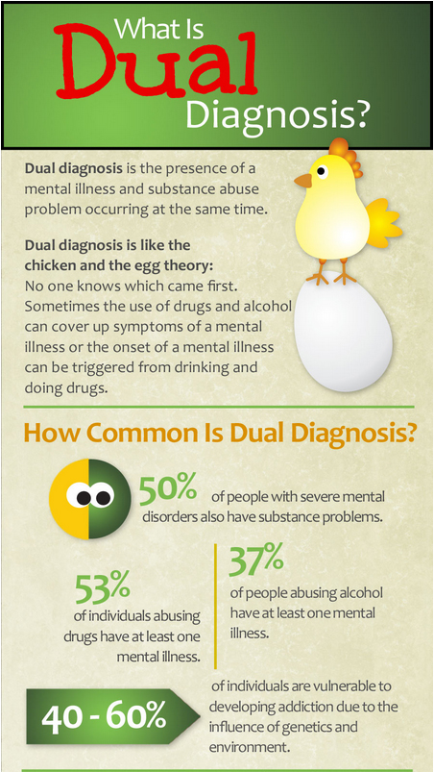
ADDICTION and MENTAL ILLNESS
Two problems,
One person
If you don’t treat
them together,
you can’t beat either – integrated treatment
is essential.
Notes:
Over 8.9 million persons have co-occurring disorders — that is, they have both a mental and substance use disorder. Early death statistic (40 years)

Slide 28

Alcohol-specific Issues
alcoholics are 2-3X more likely to be diagnosed with an anxiety disorder
more than 4X as likely to experience a major depressive episode
Notes:
According to the National Institutes of Health, alcoholics are two to three times more likely than the general public to be diagnosed with an anxiety disorder
National Institute of Alcohol Abuse and Alcoholism study found that patients with a history of alcohol addiction were more than four times as likely to experience a major depressive episode as those without a history of alcohol abuse and addiction.

Slide 29

Impact of Dual Diagnosis
For the consumer, having both mental illness and substance abuse, the consequences are numerous and harsh:
tendency for violence
medication noncompliance
failure to respond to treatment
overall poorer functioning
greater chance of relapse
tardive dyskinesia (TD) and physical illnesses/early death
experience more episodes of psychosis
high risk to contract AIDS
50% of homeless adults, 16% of jail and prison inmates
These consumers are in and out of hospitals and treatment programs without lasting success

Slide 30

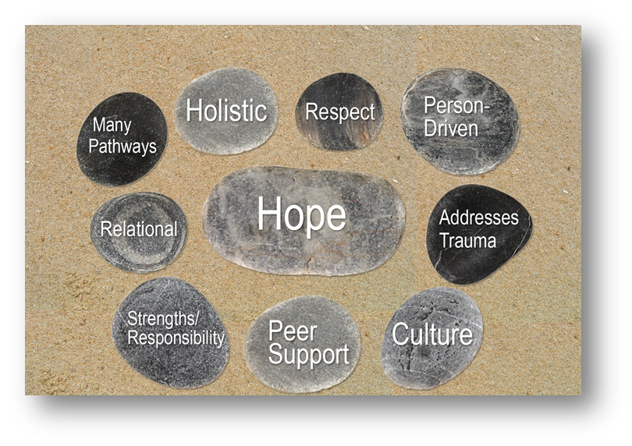
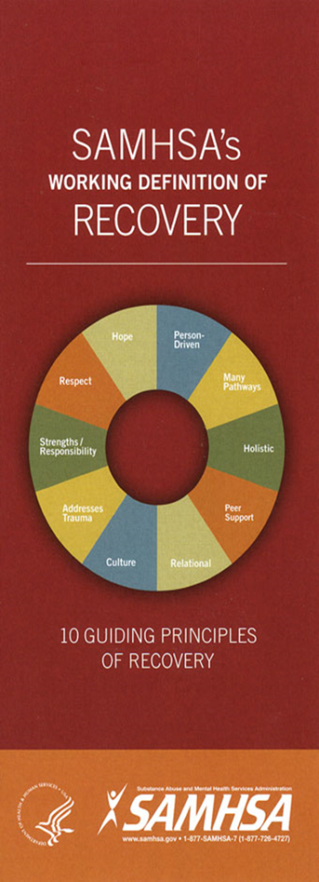
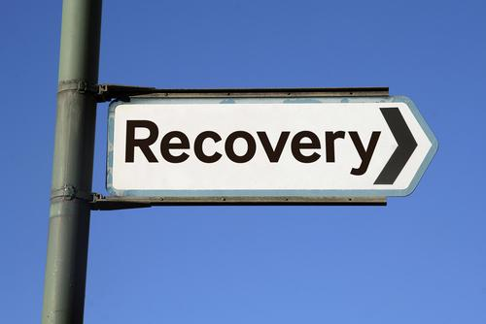
Good News!
Treatment Works!
“A process of change through which individuals improve their health and wellness, live a self-directed life, and strive to reach their full potential.”
Notes:
Recovery: “A process of change through which individuals improve their health and wellness, live a self-directed life, and strive to reach their full potential.”
This is not a cure or a remission, this is Recovery. Recovery refers to the process in which people living with mental illness are able to live, work, learn, and participate fully in their communities.
For some individuals, recovery is the ability to live a fulfilling and productive life. For others, recovery implies the reduction or complete remission of symptoms. Science has shown that hope plays an integral role in an individual's recovery
Studies show that with proper treatment, most people with mental illnesses get better, and many recover completely.
Treatment success rates for mental health disorders range from 70% to 90%, surpassing those of other medical conditions such as heart disease, which has a treatment success rate of 45-50%.
Most people diagnosed with mental illness can experience relief from their symptoms by actively participating in an individual treatment plan.
Numerous treatments and services for mental illnesses are available.
Why don’t people get treatment?
Scientific knowledge
Diagnostic tools
Lack of knowledge about available treatments, evidence-based treatments
Needed treatment is not available (i.e. trauma specific, eating disorders, etc.)
Cost/coverage
Shortage of providers esp. psychiatrists

Slide 31
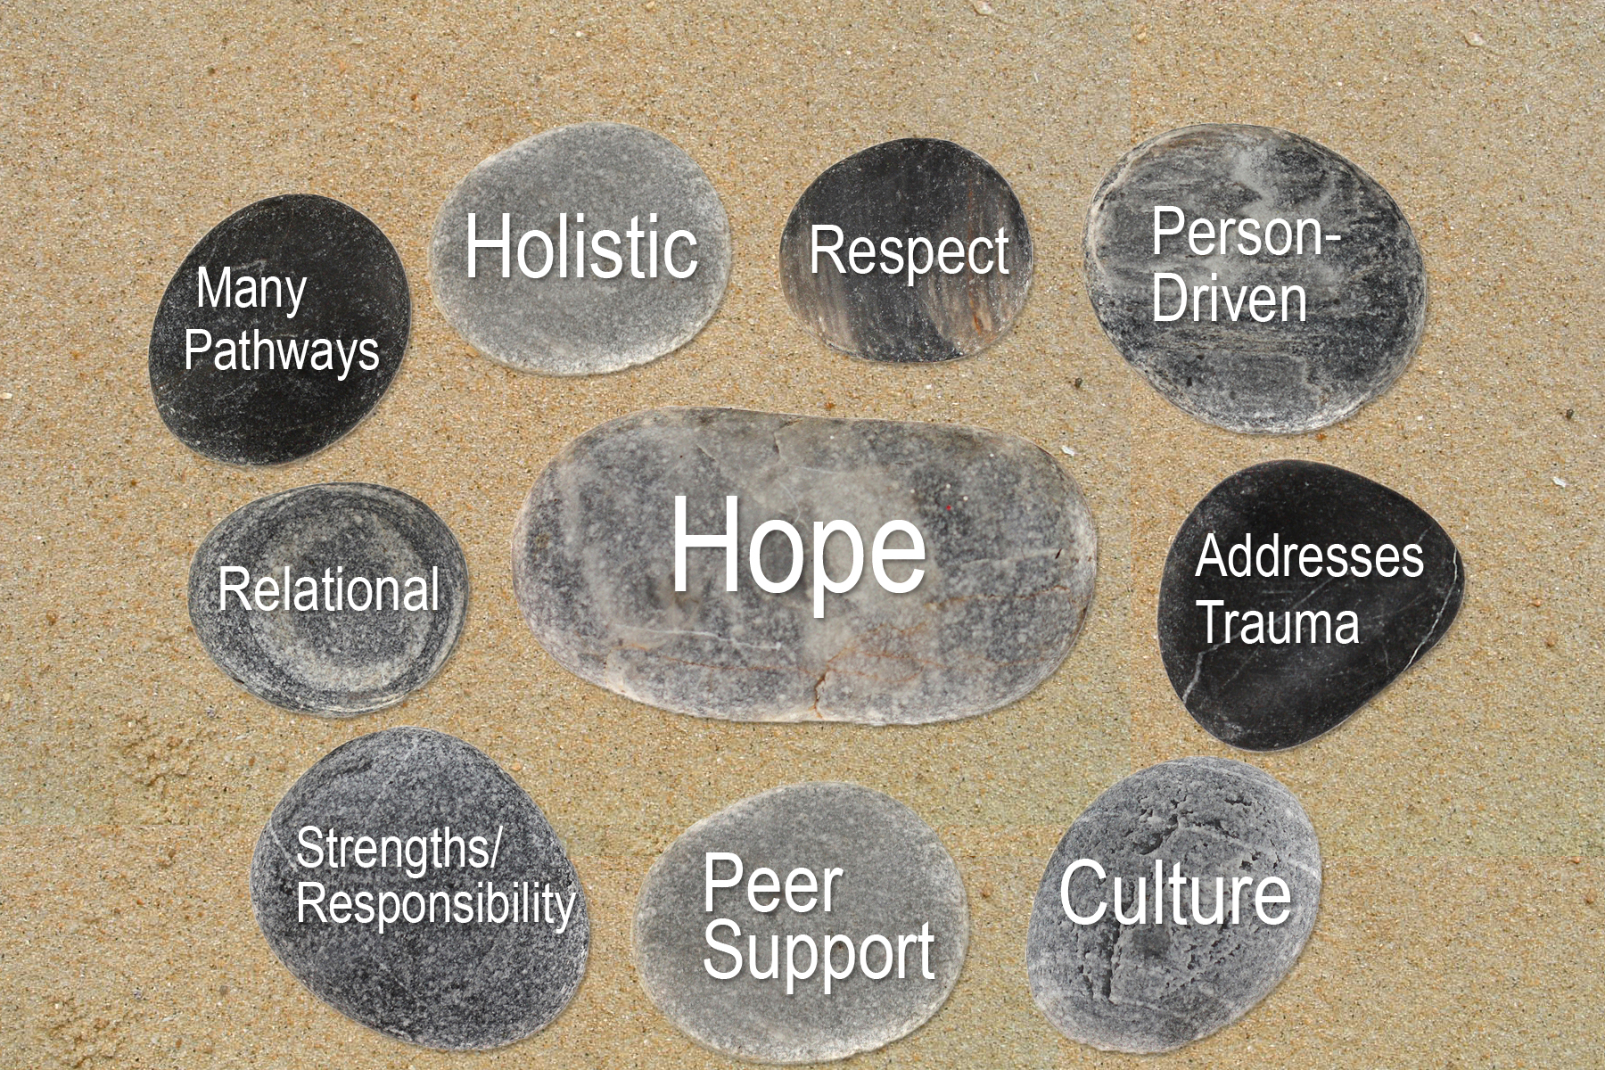
Notes:
Substance Abuse and Mental health Services Administration

Slide 32



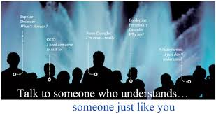








101’s – Community Education
MICA – Children/Adolescents
Notes:
About 15 programs: F2F
P2P
REAP
MICA
IOOV
CIT
CIP
Be Well
Monthly Social Events
Ending the Silence
Book Club
Coffee Clutch
Support: General MI, Mood DO, Anxiety DO, Teen (3), Family Sharing (2)
Peer Advocates
Family Advocates
Court Advocate
Community Outreach: NAMI FV 101, Mental Illness 101, Recovery 101

Slide 33


Descriptions/dates of program offerings: www.namifoxvalley.org
Call us at (920) 954-1550
Join our mailing list! (Post and/or Electronic)
Stop by 211 E. Franklin Street – we are here to help!

